Slide 1



Arsenal's Invincible Legacy vs. Today’s Premier League
A Performance & Disciplinary Analysis (2003-04 & 2023-24)
Comparing Arsenal’s performance and disciplinary records from their unbeaten season to their current form, with a broader view on Premier League trends.

Slide 2
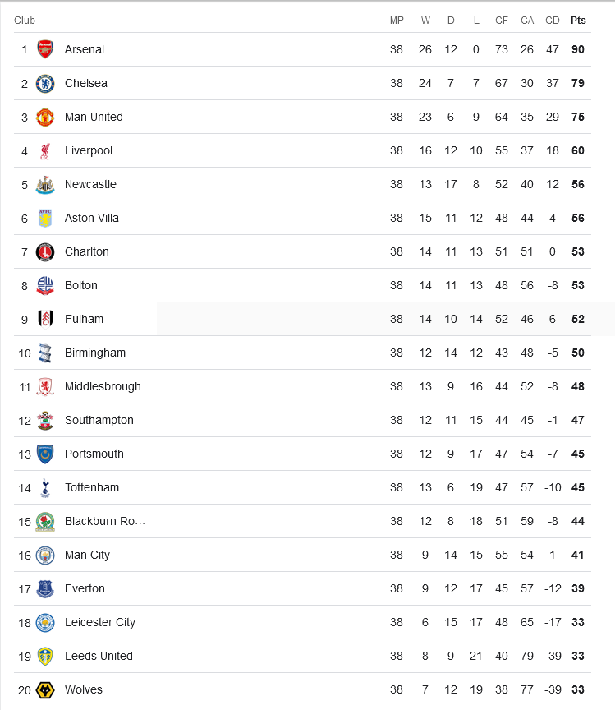
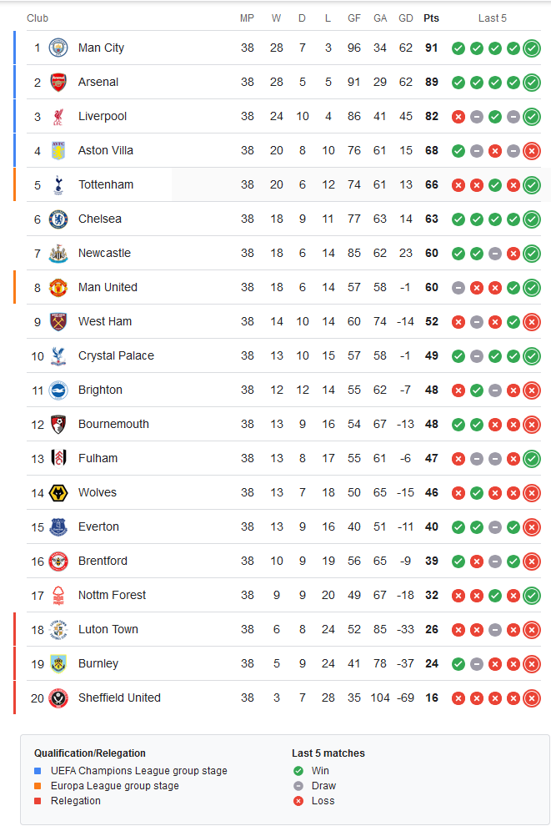
Introduction
This presentation examines Arsenal’s legendary 2003-04 season, during which they went unbeaten, alongside their current 2023-24 season. We compare Arsenal’s key performance metrics (goals, shots, corners) and disciplinary data (fouls, yellow and red cards). We also explore broader trends in the Premier League’s disciplinary data over the two periods.
Key Focus:
How Arsenal’s Invincible season stands out in football history.
The runners-up finish in 2022-23, just two points behind Manchester City.
Arsenal’s performance and discipline in the 2023-24 season, compared to the broader Premier League.

Slide 3
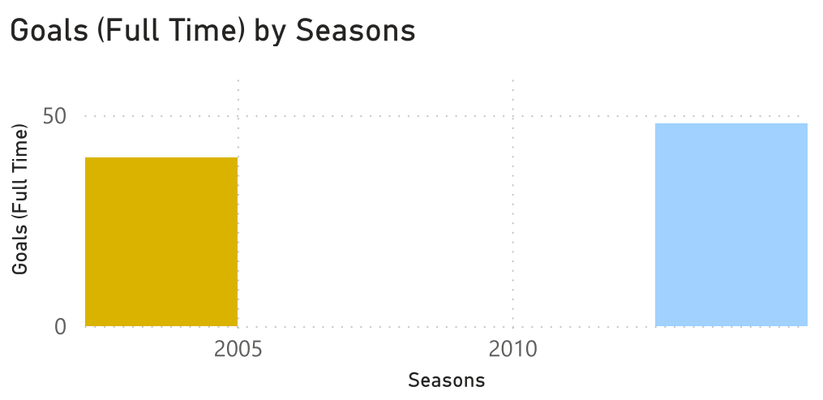
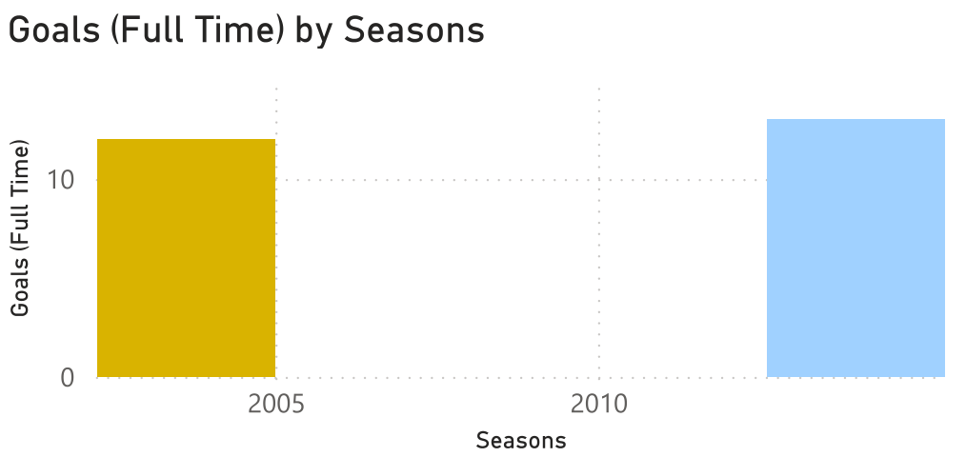
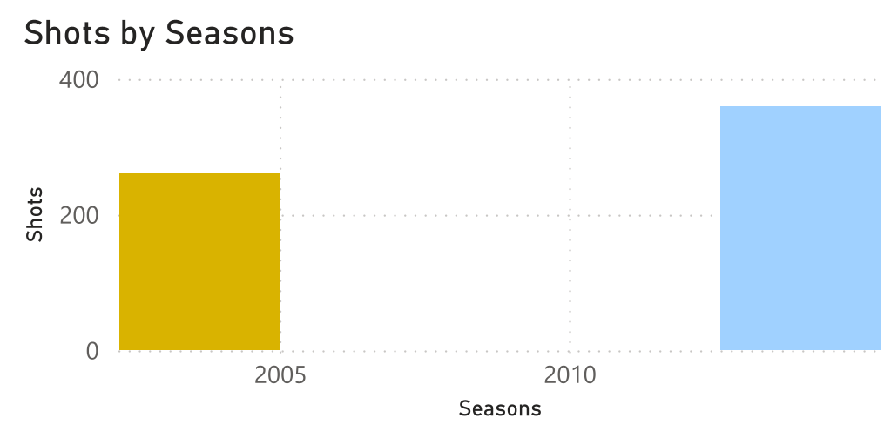
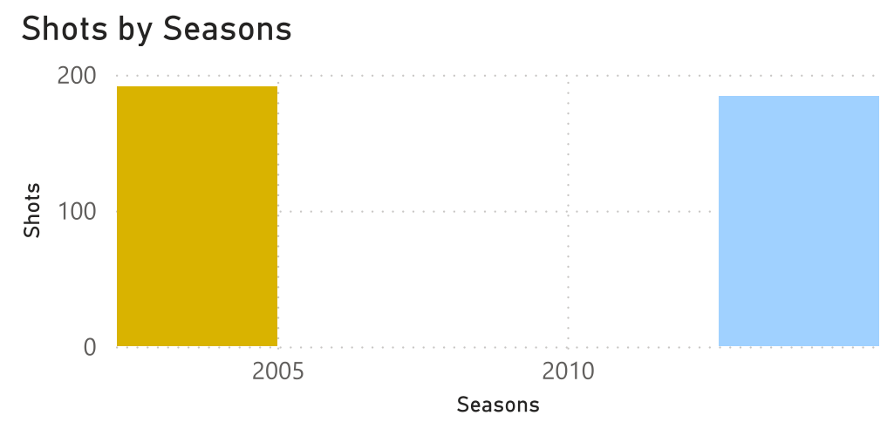
Arsenal’s Performance: 2003-04 vs. 2023-24
In the 2003-04 season, Arsenal dominated the league with efficient offensive play, converting a high number of shots into goals. Their ability to generate corner kicks and create goal-scoring opportunities through set-pieces was critical.
In the 2023-24 season, Arsenal maintains a strong offensive presence with similar numbers of shots and corners. However, goal conversion rates suggest that modern defences have become tougher, resulting in fewer goals despite high shot counts.
Explanation: The 2003-04 Invincible squad was efficient, scoring more goals from fewer chances. Today’s Arsenal is creating more opportunities but converting fewer, a sign of both tactical evolution and stiffer competition.
Key Metrics:
Goals
Shots & Shots on Target
Corners

Slide 4
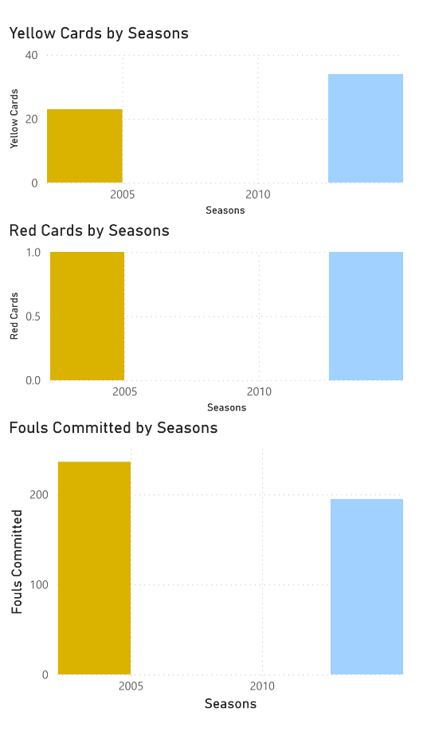
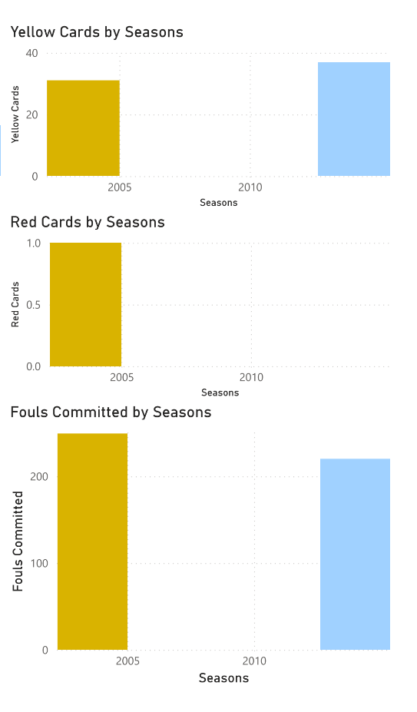
Arsenal’s Disciplinary Records: 2003-04 vs. 2023-24
During the Invincible season, Arsenal had a controlled approach to discipline, committing fewer fouls and receiving fewer yellow and red cards. This allowed the team to keep momentum without losing players to suspensions.
In 2023-24, the disciplinary record shows more yellow cards being handed out to Arsenal players, reflecting tighter refereeing and more aggressive gameplay. However, red cards remain low, indicating that while the team may push the limits, they are still able to avoid serious infractions.
Explanation: The rise in yellow cards in 2023-24 can be attributed to modern football’s high-intensity environment and stricter enforcement of minor fouls. The low number of red cards shows that Arsenal continues to manage serious offences well.
Key Metrics:
Fouls Committed
Yellow Cards
Red Cards

Slide 5
Premier League Disciplinary Trends: 2003-04 vs. 2023-24
Across the Premier League, fouls have slightly decreased, but yellow cards have increased since 2003-04. This trend suggests a shift towards a less physical, more technical style of play. Red cards, while still rare, have not risen significantly, reflecting disciplined defending in high-pressure games.
Key Metrics:
Premier League Fouls
Yellow Cards
Red Cards
Explanation: The overall rise in yellow cards reflects the modern game's tighter officiating standards. Fewer fouls may indicate that teams are focusing on more technical, possession-based play to avoid unnecessary physical confrontations.

Slide 6
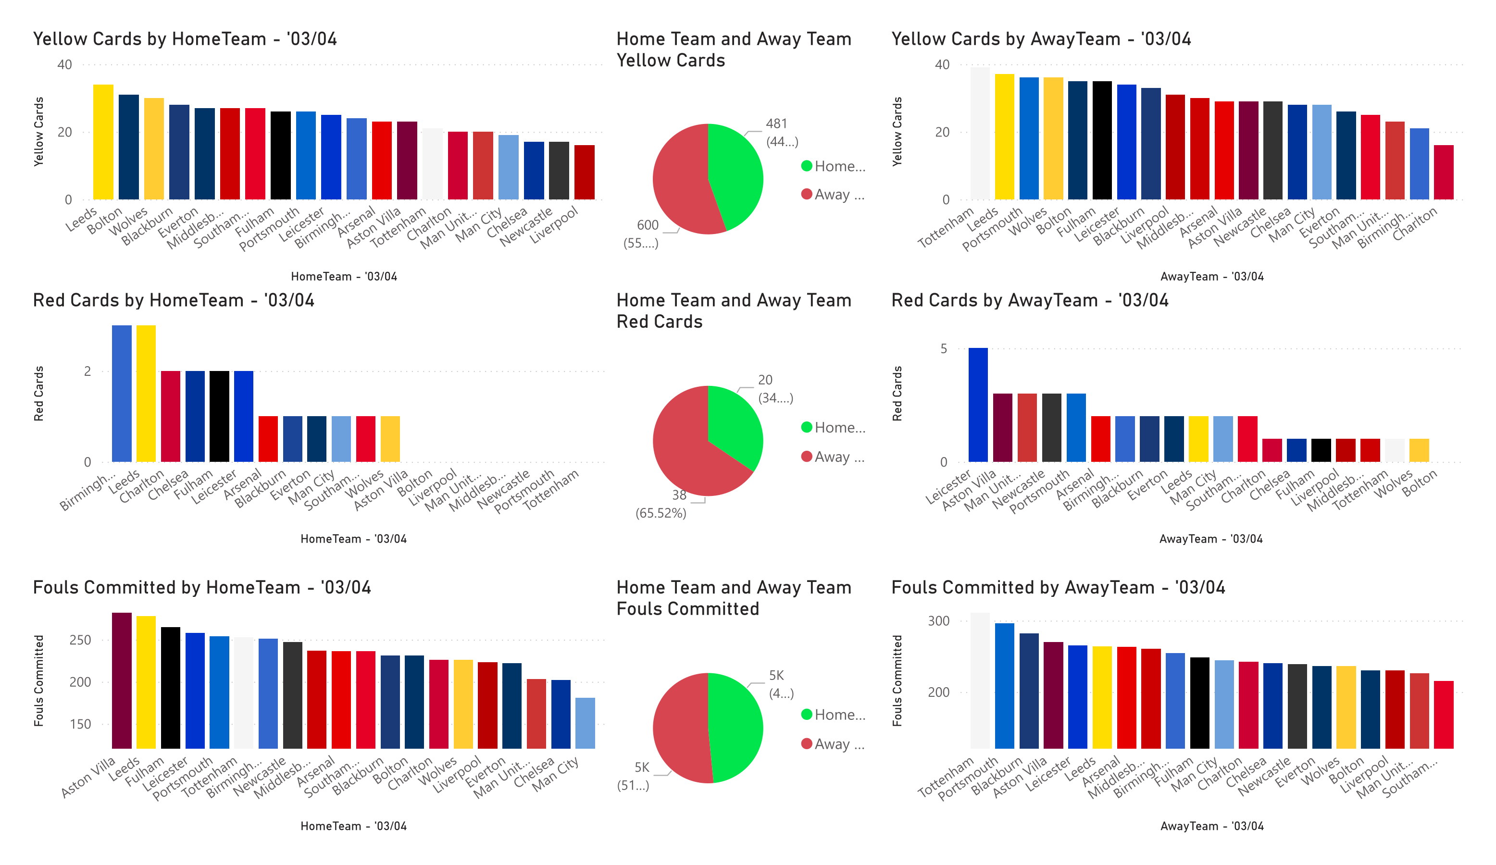

Slide 7
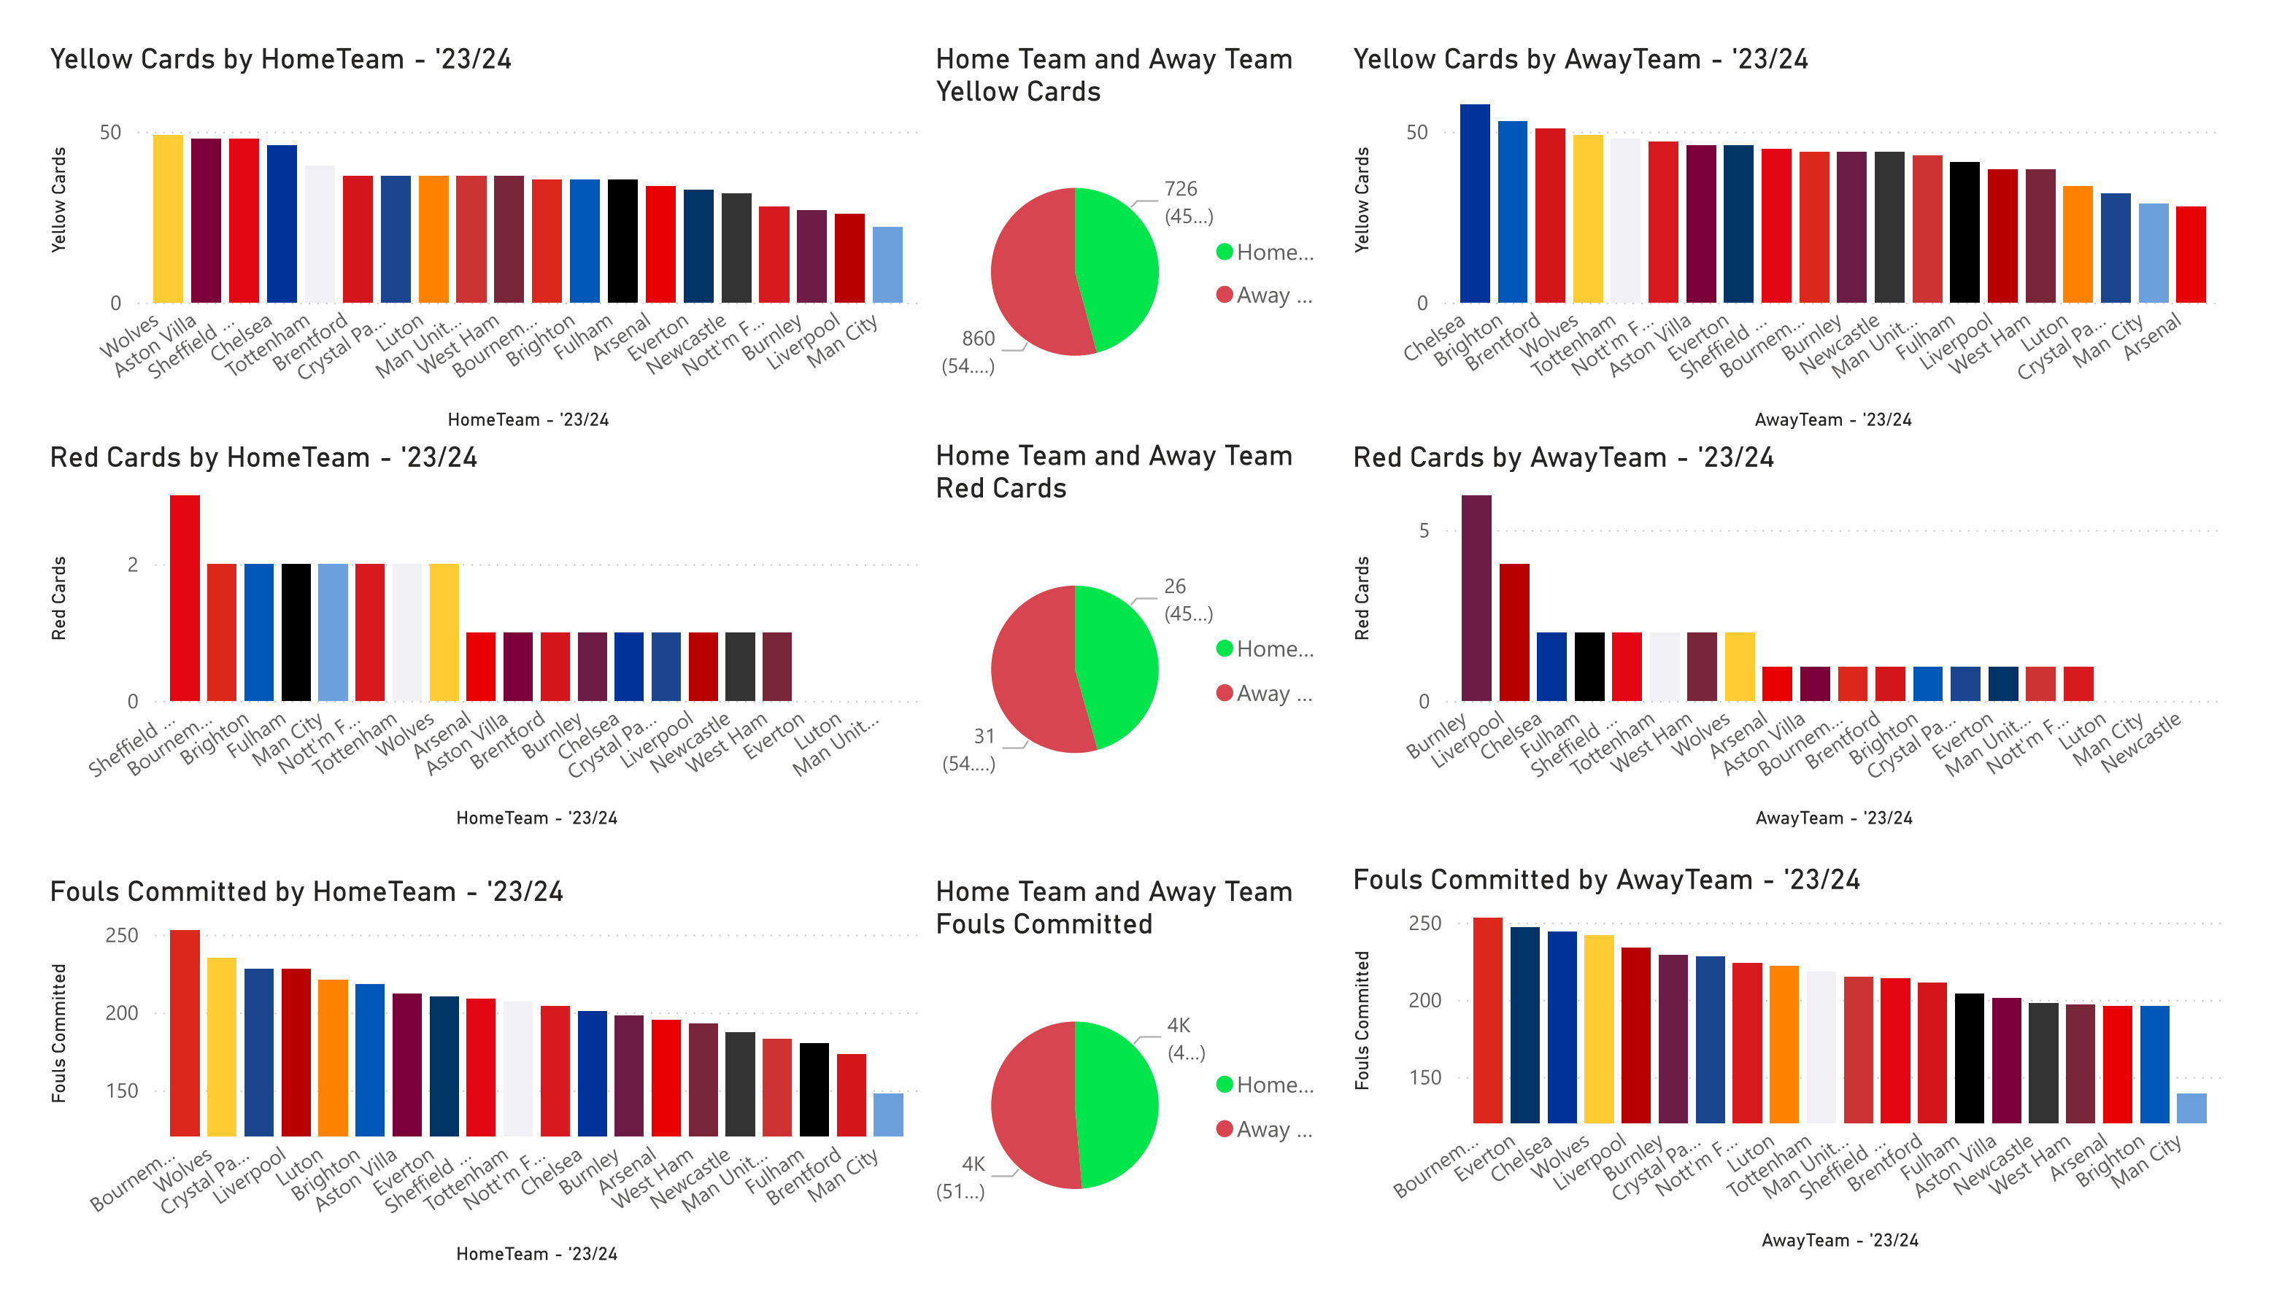

Slide 8
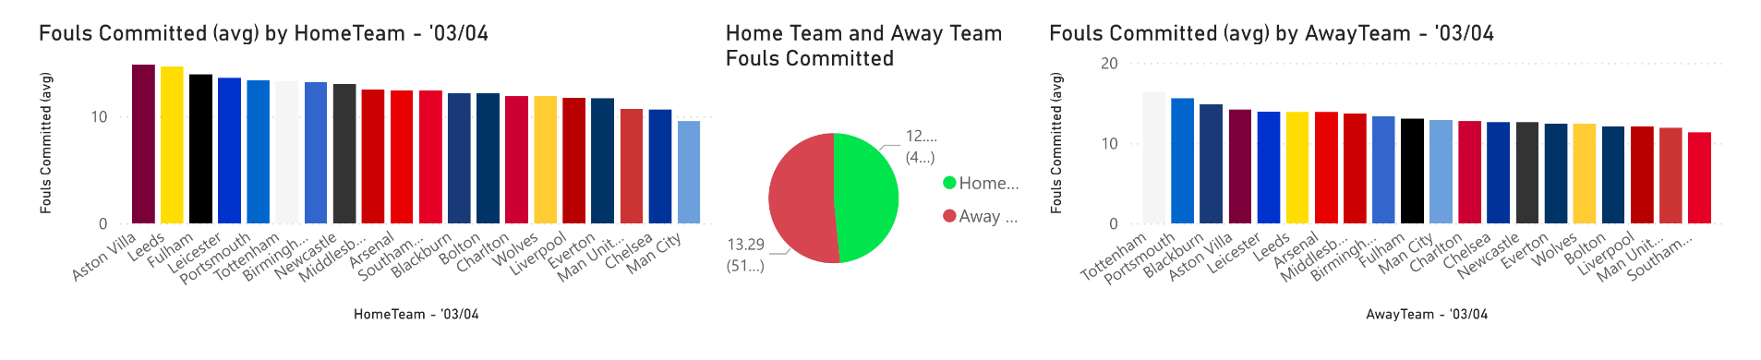
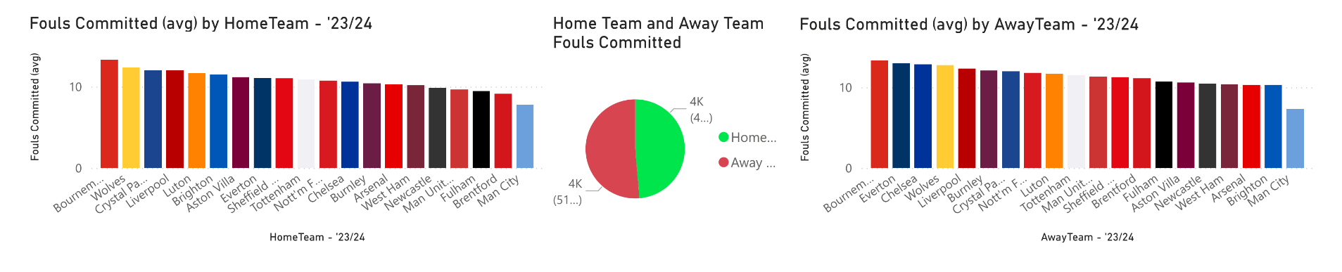
Comparison of Fouls Committed: Arsenal vs. Premier League
Arsenal has consistently committed fewer fouls compared to the Premier League average, especially in 2023-24. This suggests a more tactical and disciplined approach to defending. The Premier League trend shows a general decline in fouls, likely due to stricter refereeing and evolving strategies.
Explanation: Arsenal’s ability to maintain a low foul count while competing at the highest level is a testament to their tactical discipline. This contrasts with the league-wide reduction in fouls, indicating a broader shift in how teams approach defensive play.

Slide 9
Yellow and Red Cards: Arsenal vs. Premier League
Arsenal’s rise in yellow cards reflects a broader Premier League trend where minor infractions are penalised more often. However, Arsenal remains below the league average in both yellow and red cards, indicating that while the game has become more intense, Arsenal continues to play within acceptable limits.
Explanation: The increase in yellow cards is a reflection of the modern game’s demands, but the relatively low number of red cards suggests that Arsenal’s defensive discipline remains a key strength.

Slide 10
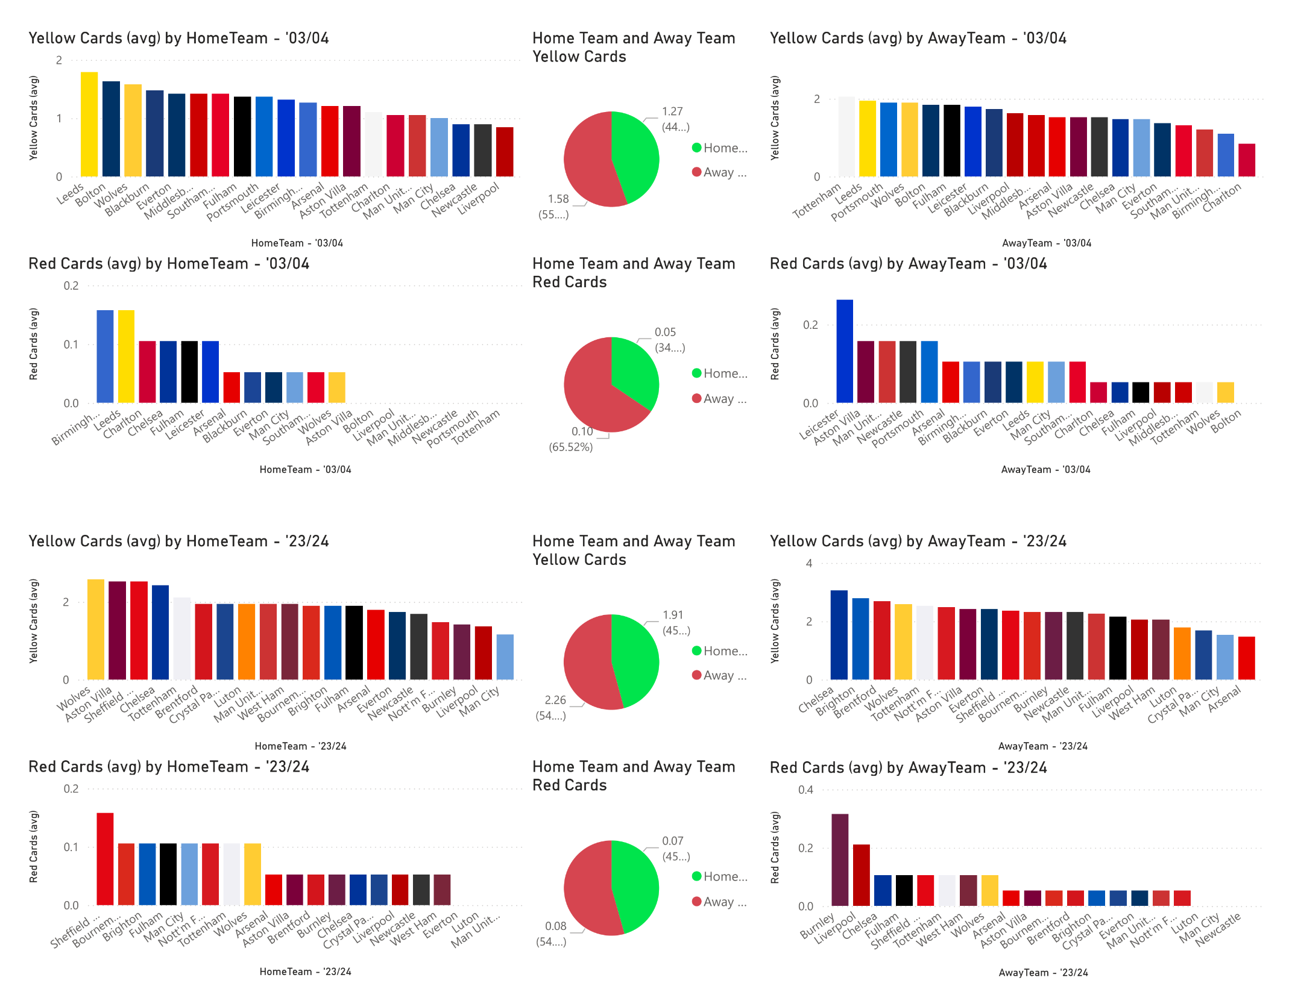

Slide 11
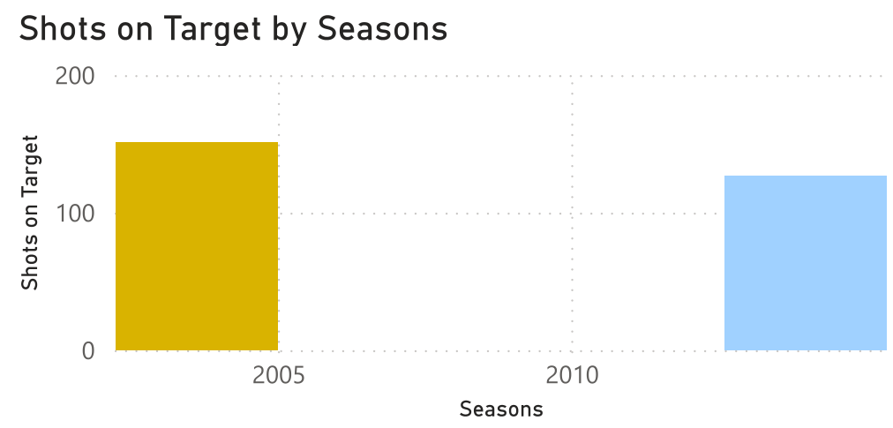
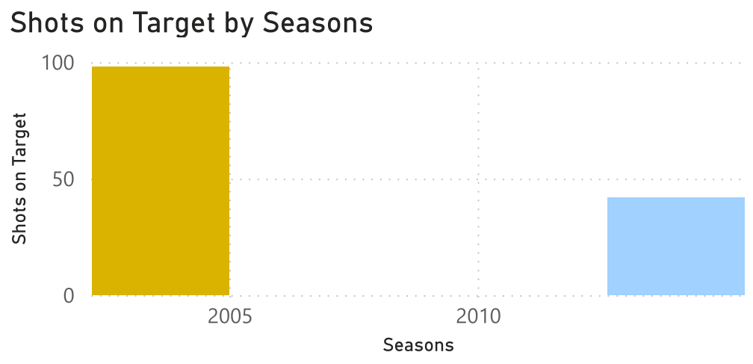
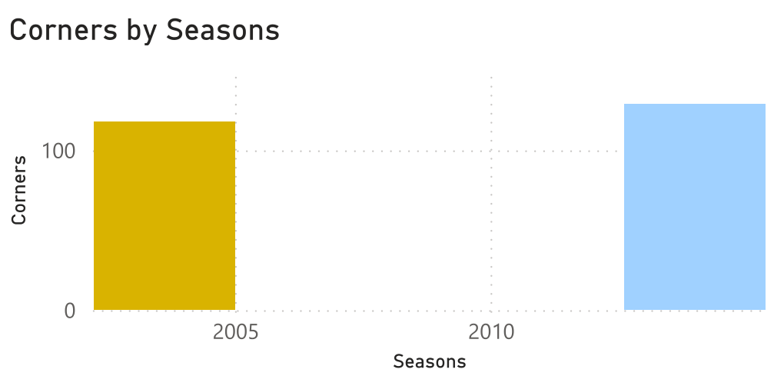
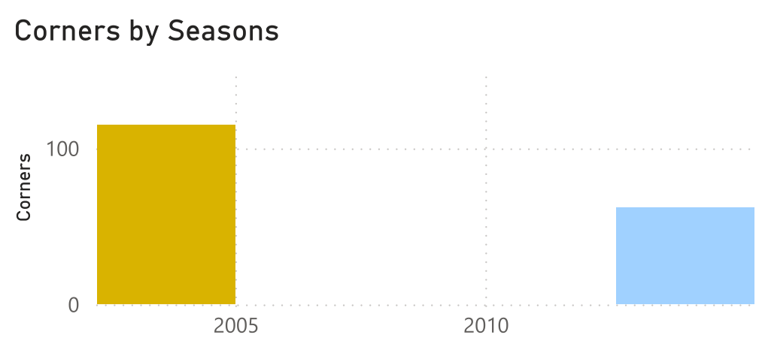
Evolution of Arsenal’s Offensive Play: 2003-04 vs. 2023-24
Arsenal’s offensive metrics—goals, shots, and corners—show a clear evolution. The 2023-24 team relies more heavily on corners, perhaps reflecting modern football’s emphasis on set-pieces. Shots remain consistent with the 2003-04 team, but goal conversion has slightly dropped, indicating stronger defences across the league.
Explanation: Corners play a larger role in today’s game, and while Arsenal continues to generate many shots, converting those into goals remains a challenge compared to the efficiency of the 2003-04 Invincibles.

Slide 12
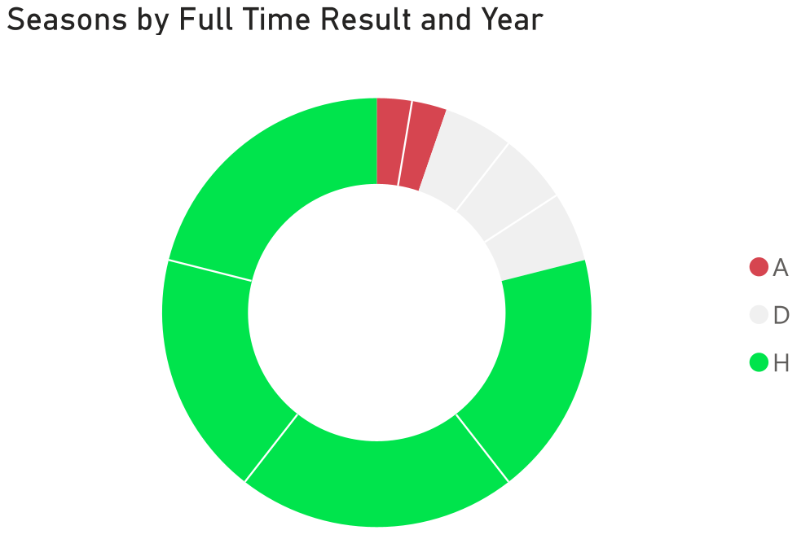
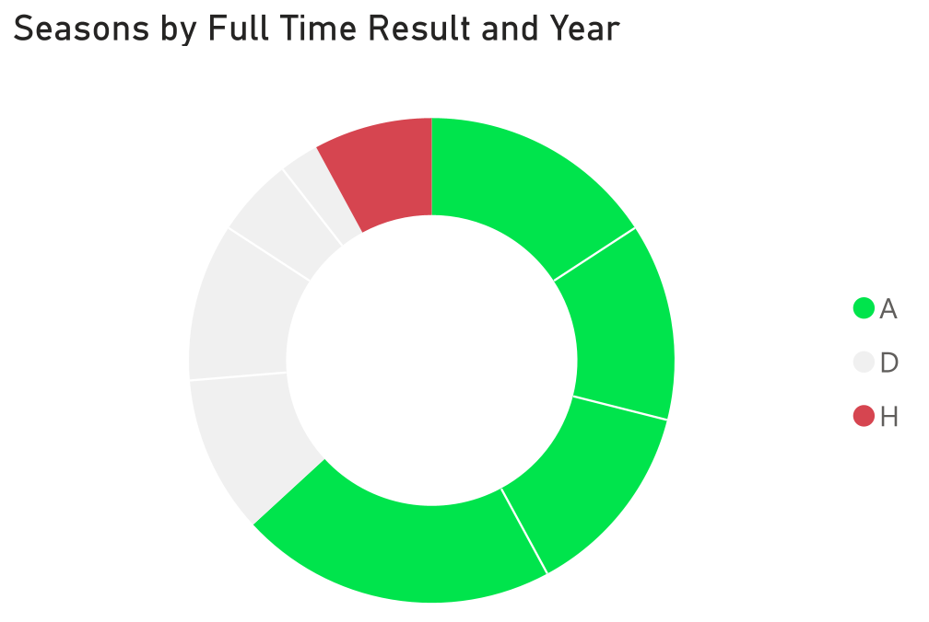
Impact of Discipline on Team Performance
The 2003-04 season saw Arsenal maintaining discipline while excelling in performance. Fewer cards meant fewer suspensions, allowing the team to keep its best players on the pitch. In 2023-24, while yellow cards have increased, Arsenal continues to avoid major infractions, helping them maintain competitive performance.
Explanation: Arsenal’s ability to control aggression while remaining disciplined has been a hallmark of both the 2003-04 and 2023-24 teams. This balance is key to sustaining performance at the highest level.

Slide 13
Conclusion and Key Takeaways
Arsenal’s performance and disciplinary records highlight the evolution of football over the past two decades. The Invincibles of 2003-04 set a high standard for both offensive efficiency and disciplined play, while today’s Arsenal, though facing stiffer competition, continues to compete at the highest level. Across the Premier League, disciplinary trends reflect the changing nature of the game, with fewer fouls but more yellow cards.
Key Takeaways:
Arsenal’s offensive play remains strong, but modern defences are tougher.
The rise in yellow cards across the Premier League reflects tighter officiating.
Despite increased pressure, Arsenal continues to manage discipline effectively, avoiding serious infractions that could impact performance.

Slide 14
Further Reading & Data Insights in Modern Football
For a deeper dive into how data and analytics have transformed modern football, particularly for top-tier teams like Arsenal, the following resources provide valuable insights:
How Arsenal Use STATSports Technology To Optimal Effect Arsenal's innovative use of STATSports to monitor player performance and enhance tactical decisions through real-time data.
Maximizing Team Performance Through Data Analytics Learn about the growing role of analytics in football and how teams like Arsenal leverage data to optimise match strategies and player performance.
Has the impact of analytics on modern football been ... Explore the broader impact of analytics across football, from performance tracking to recruitment and tactical planning.
How data departments have evolved and spread across ... Discover how football clubs have built extensive data departments to gain a competitive edge in the modern game.
Arsenal Kicks Off Digital Revolution with NTT Data Arsenal partners with NTT Data to spearhead a digital transformation, revolutionising their approach to data and technology integration on and off the pitch.

